Slide 1
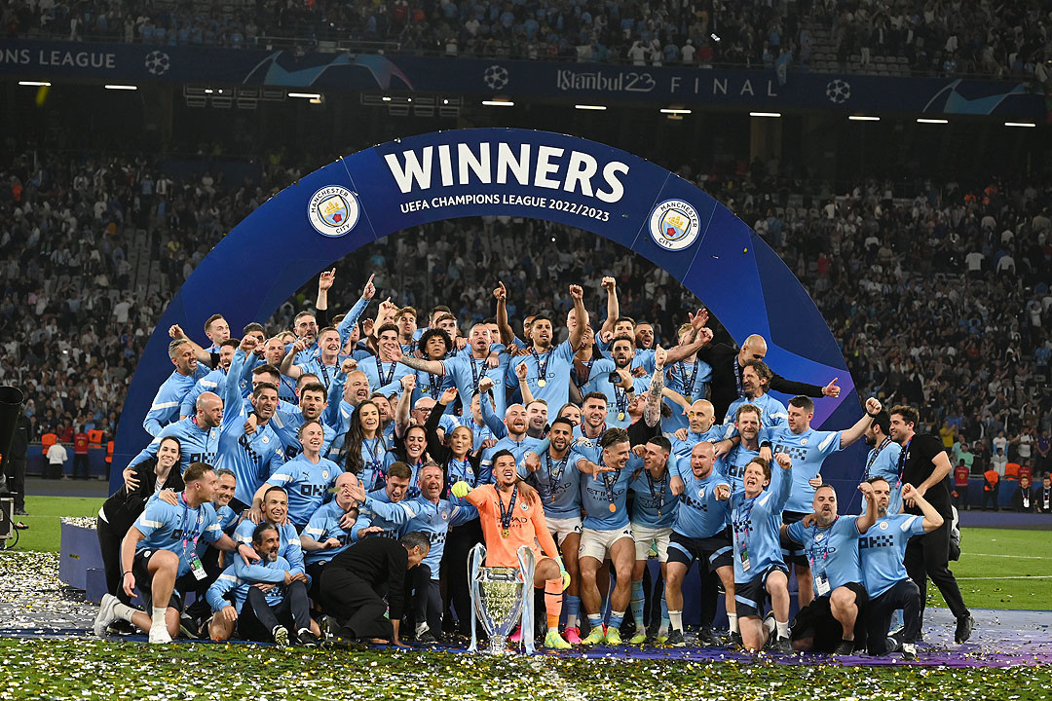
REVISITING THE 2022/23 TEAMS OF THE SEASON
Analysis by Ebubechukwu Nwoke

Slide 2
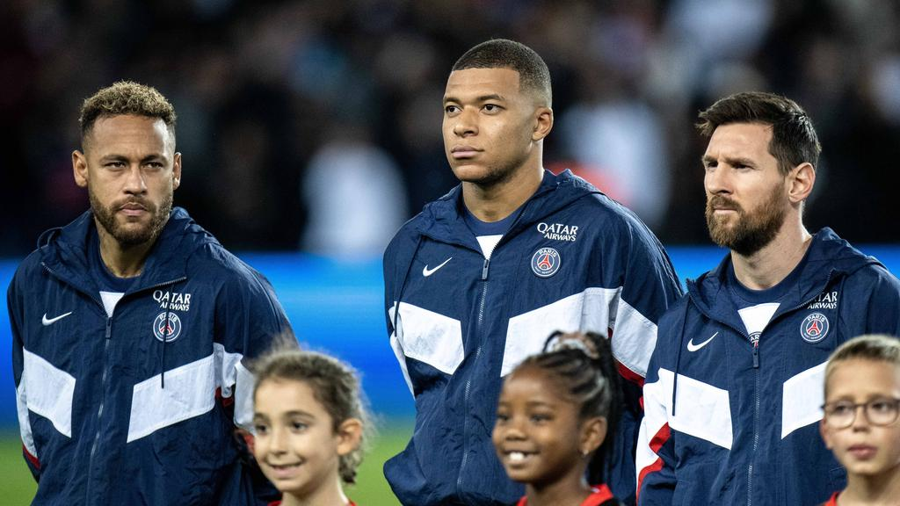
Introduction
Stats play a huge part in sports, and they play a major role in drawing conclusions. What if we used them for 100% of our conclusions?

Slide 3
Agenda
01
Data Cleaning Process
02
Exploratory Data Analysis
03
Revised Teams of the Season
04
Parting Thoughts

Slide 4
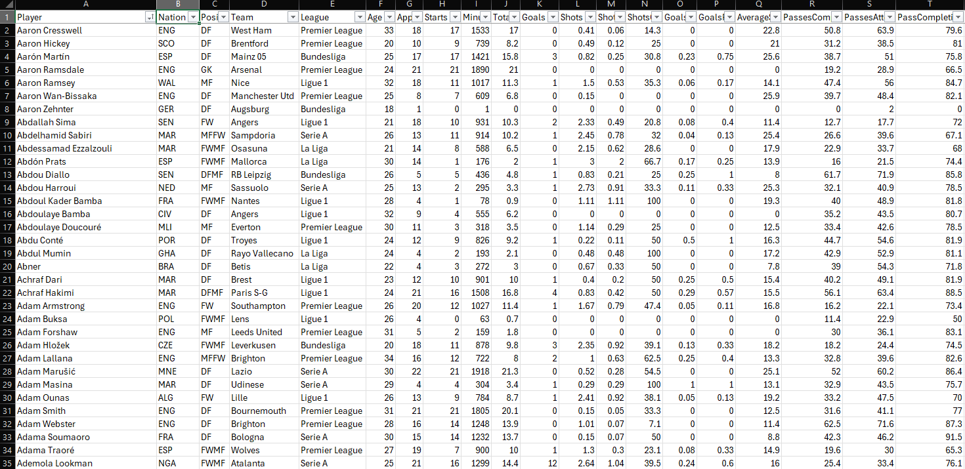

Slide 5
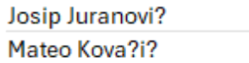
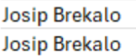
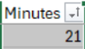
Data Cleaning Process
Fixing Player Names
Removing Duplicate Players
Applying a Minutes Limit

Slide 6
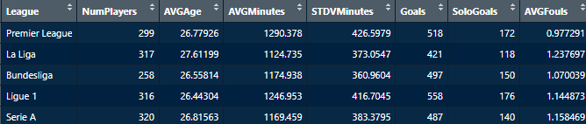
League Comparisons

Slide 7
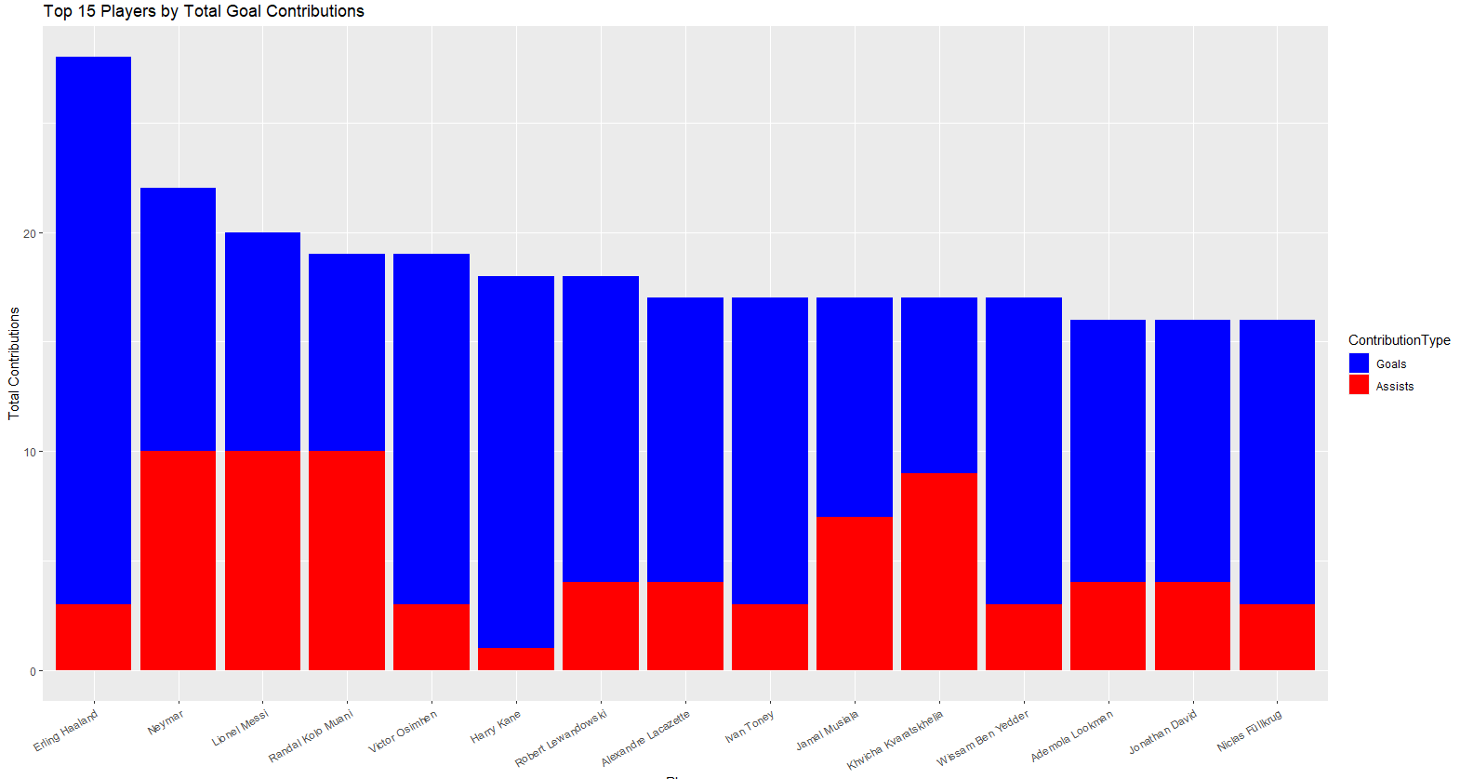
15 Players with the most G/A in Europe

Slide 8
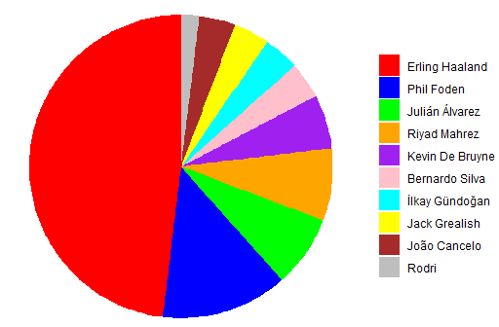
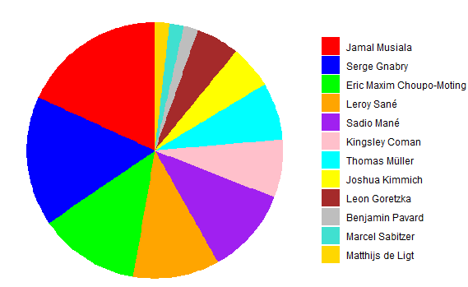
Goal Distribution between 2 League Winners
Manchester City FC (England)
FC Bayern München (Germany)

Slide 9
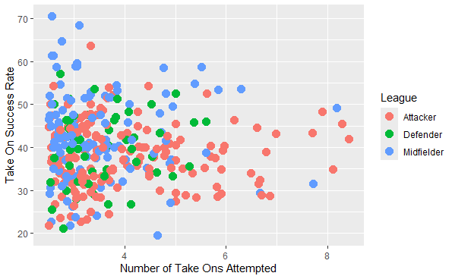
Take on Success Rate Across Europe
(minimum 2.5 Attempts per 90)

Slide 10
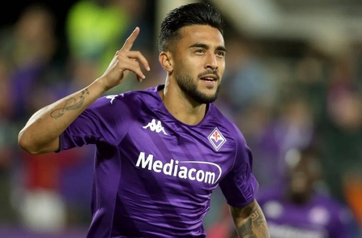
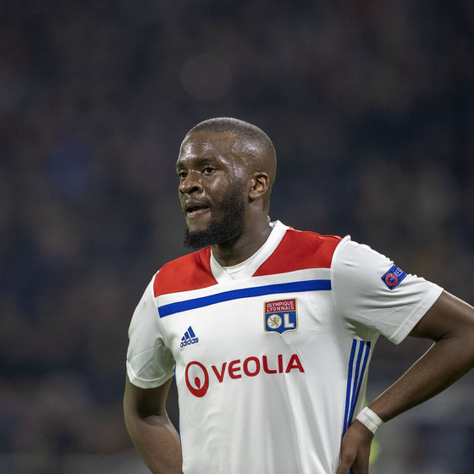
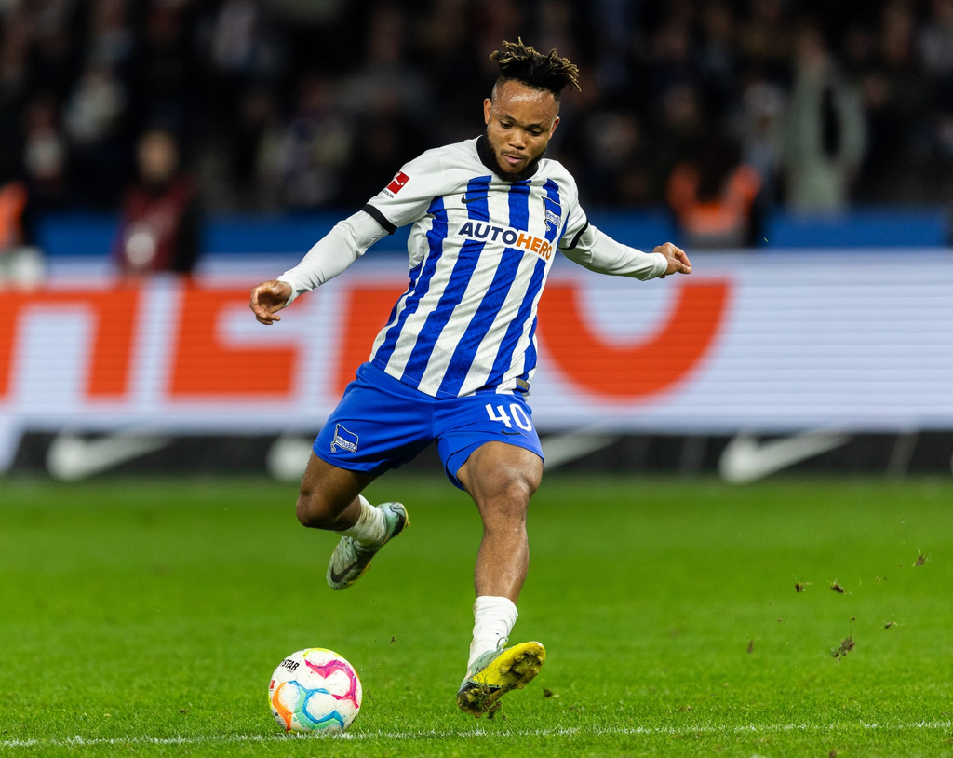
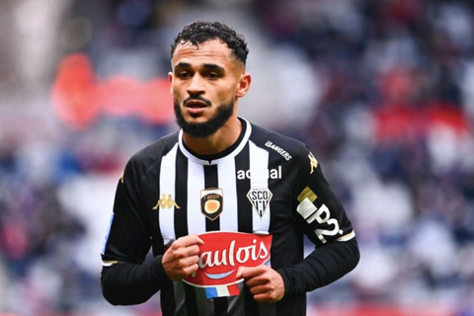

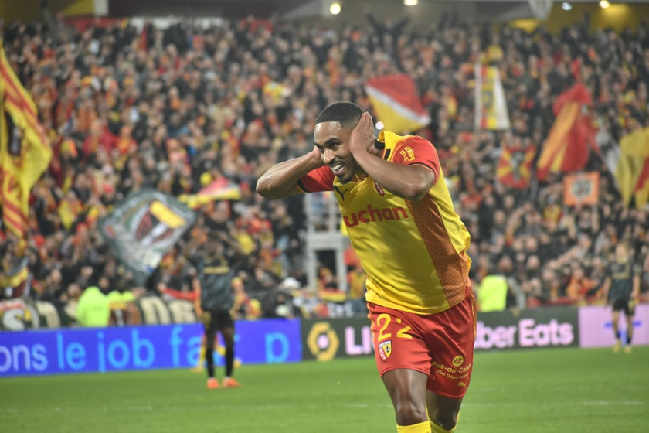
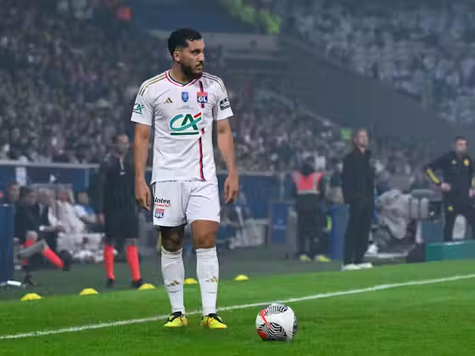
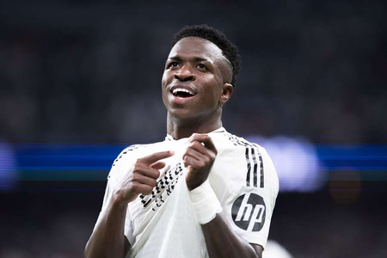
The 4 Most Successful Dribblers
The 4 Most Frequent Dribblers
Nicolas Gonzalez (70.6%)
Tanguy Ndombele (68.4%)
Chidera Ejuke (8.41 per90)
Sofiane Boufal (8.28 per90)
Iker Munain (64.7%)
Wesley Said (63.6%)
Rayan Cherki (8.18 per90)
Vinicius Jr. (8.10 per90)

Slide 11
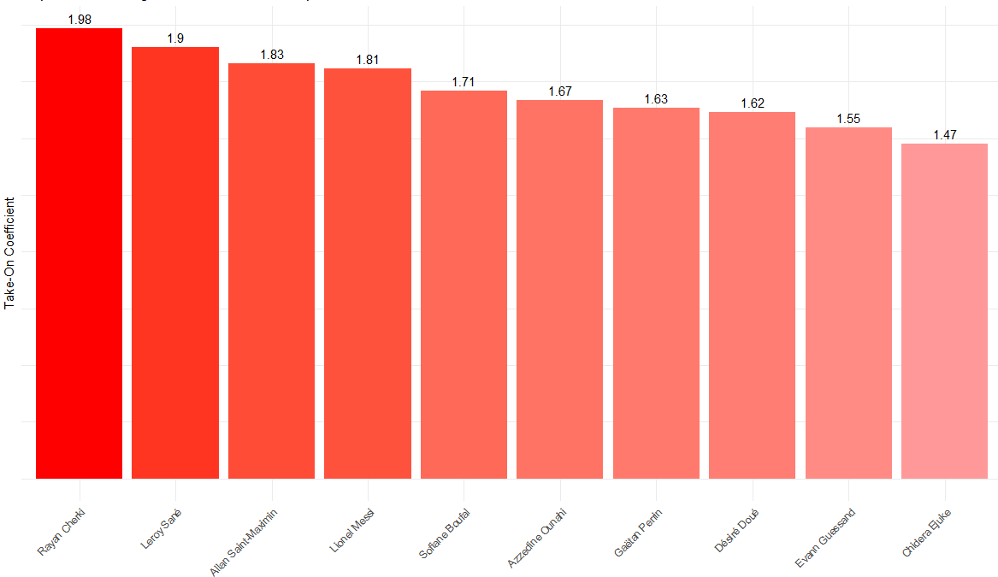

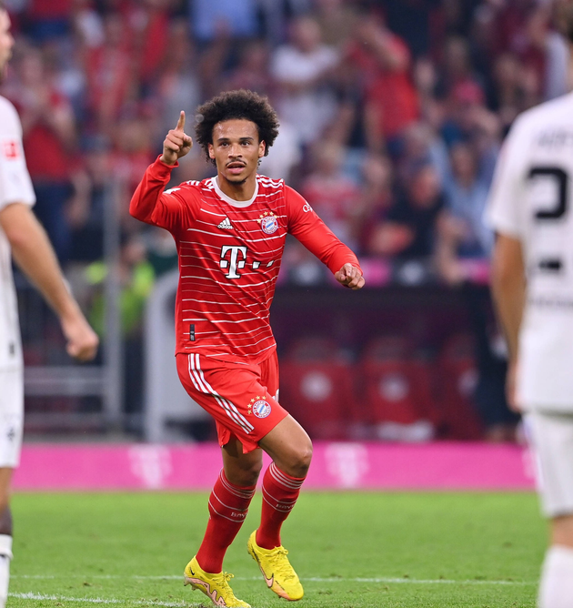

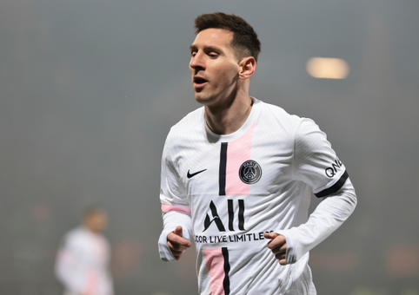
The Most Dangrous Dribblers in Europe
Rayan Cherki (1.98 TOCoeff)
Leroy Sane (1.9 TOCoeff)
Allan Saint-Maximin (1.83 TOCoeff)
Lionel Messi (1.81 TOCoeff)

Slide 12
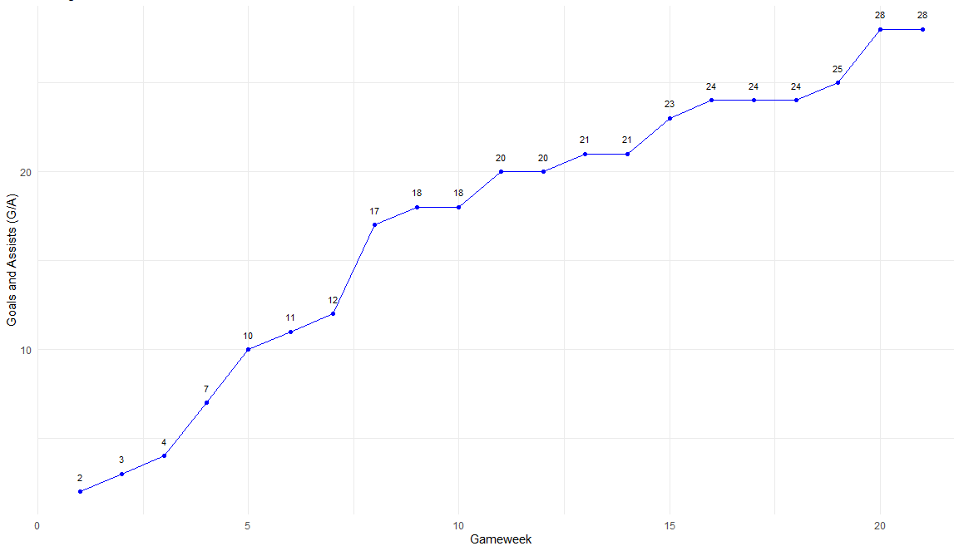

Linear Modeling: Predicting Erling Haaland’s Final Goal Tally
Erling Haaland’s GA Over First 22 Gameweeks

Slide 13
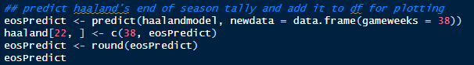
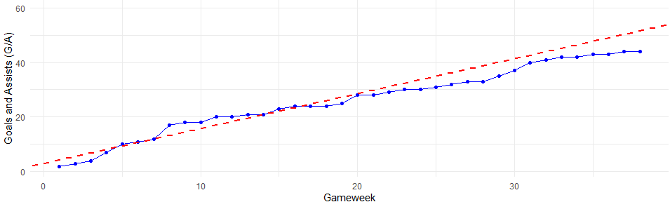

Model Prediction: 52 G/A
Haaland’s EoS Total: 44 G/A

Slide 14





Revised Teams Of The Season
Across Top 5 Leagues

Slide 15
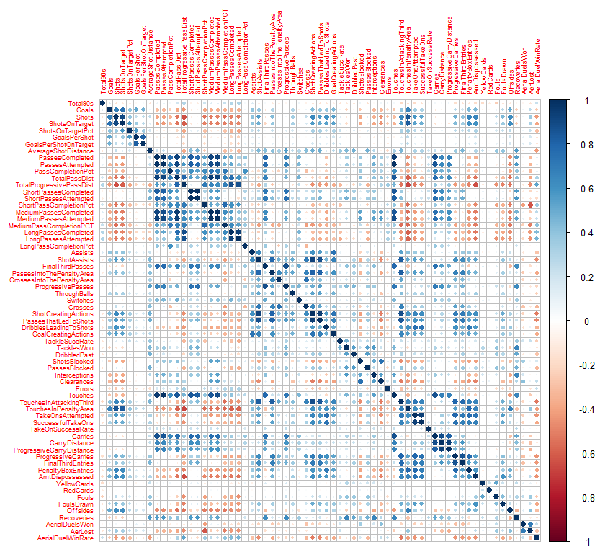
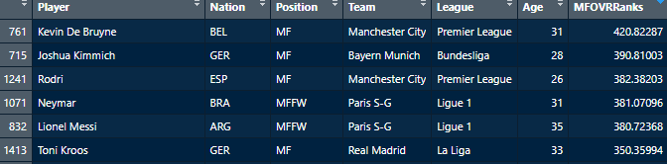
Steps Taken
Separate Players into their position Classes
Adjust all numeric stats, making them a Z score compared to the mean of the stat’s subset
Pick the most important stats and weight them accordingly
Add those values and rank every player's final score
Take the top 5 from each position class and make a starting XI based on that pool
For OVR TOTS, use the UEFA League Index to fairly weigh in the difficulty of different leagues

Slide 16
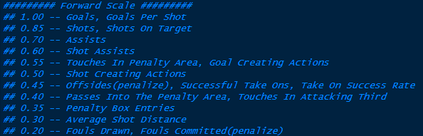
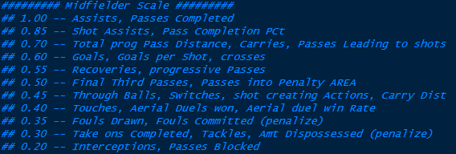
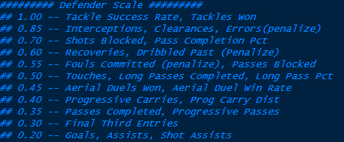
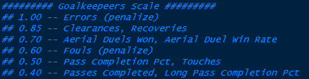

Slide 17
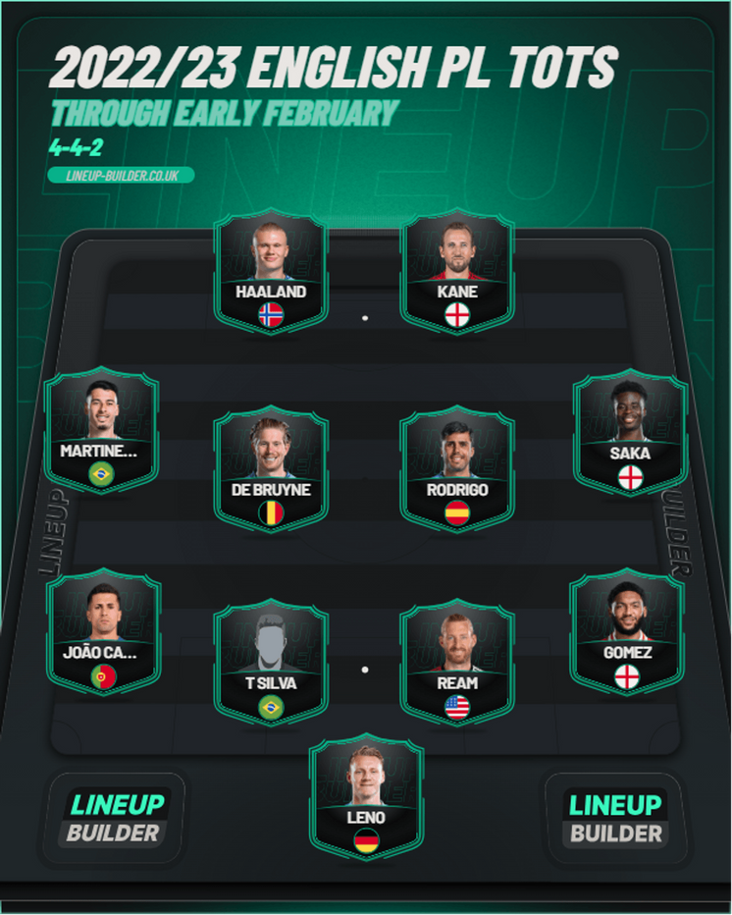
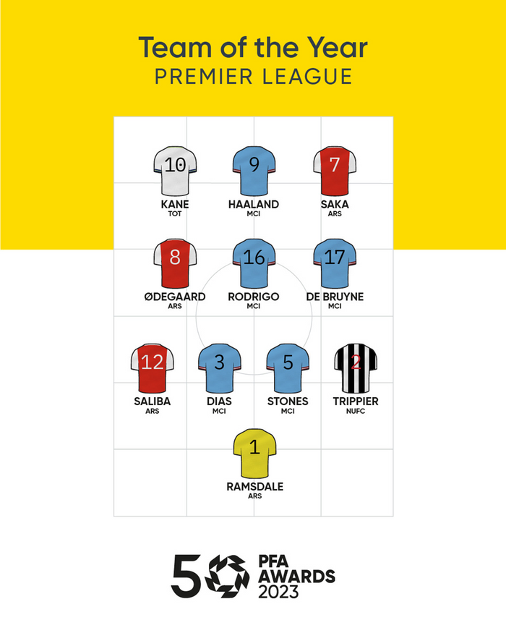
Premier League (England)
Calculated TOTS
Official TOTS

Slide 18
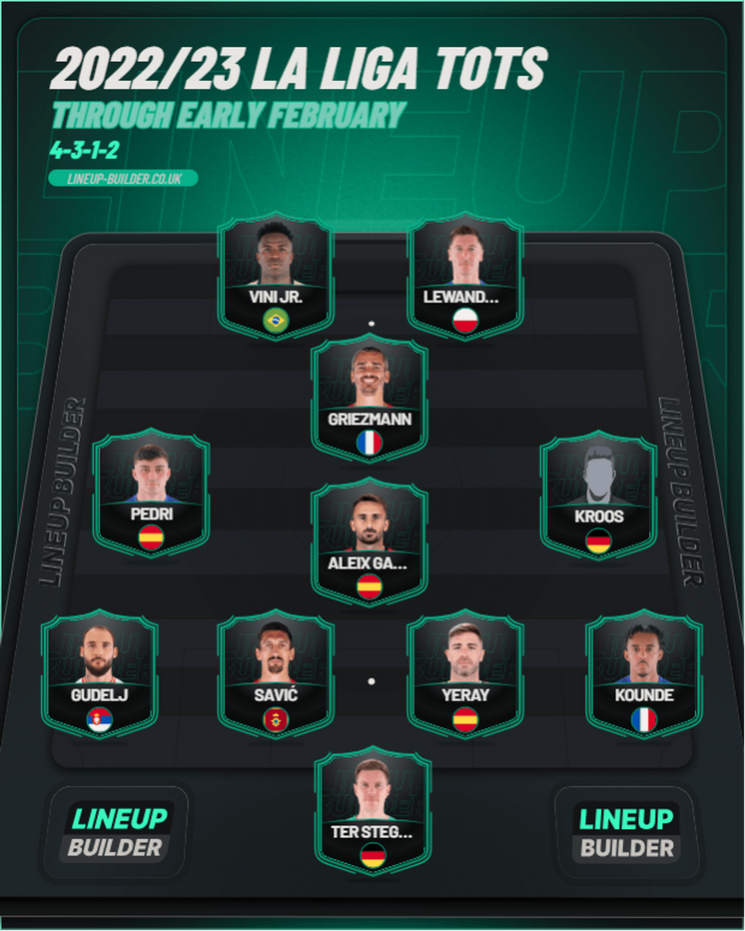
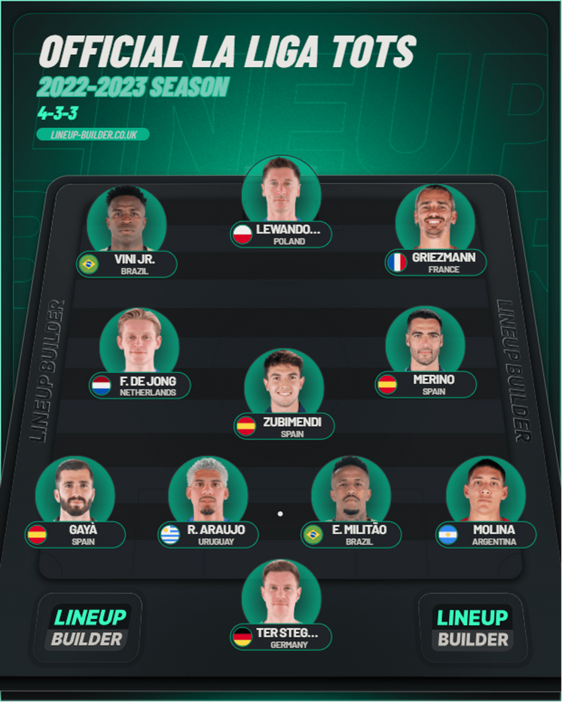
La Liga (Spain)
Calculated TOTS
Official TOTS
(no official graphic)

Slide 19
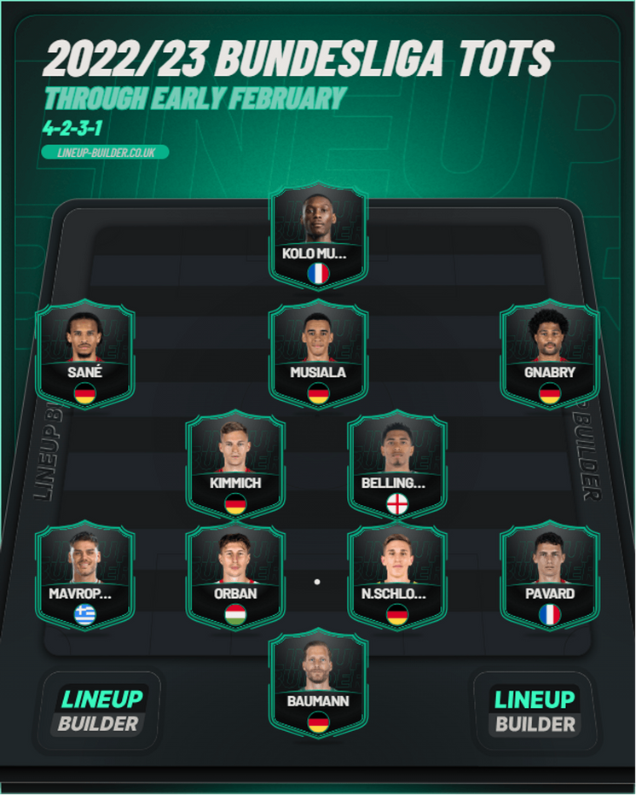
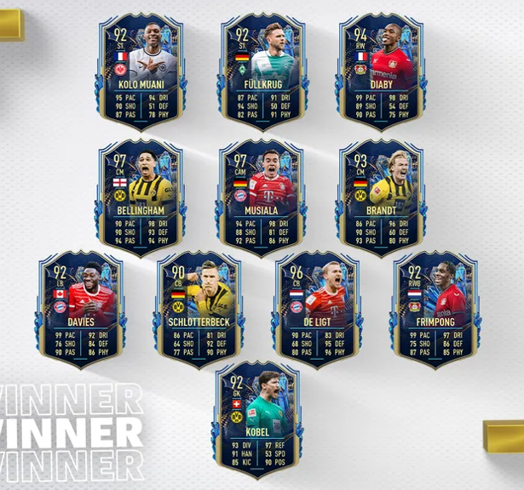
Bundesliga (Germany)
Calculated TOTS
Official TOTS

Slide 20
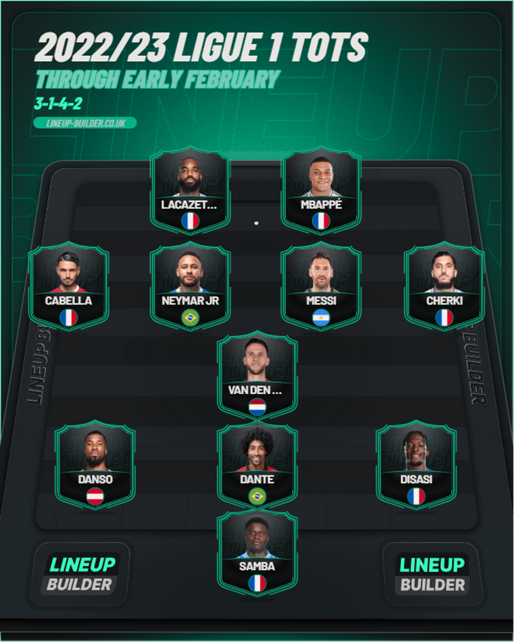
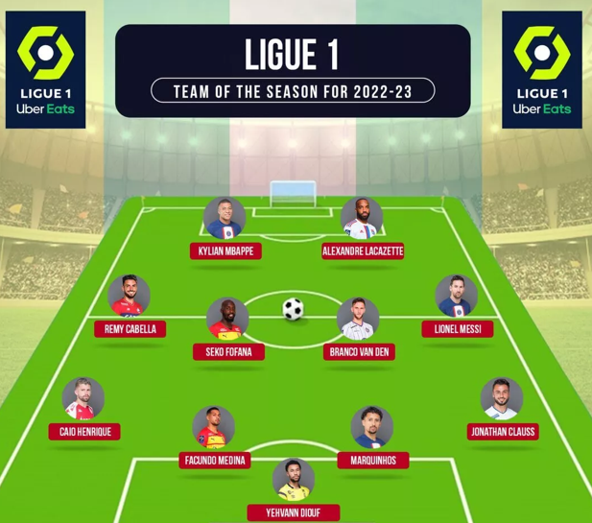
Ligue 1 (France)
Calculated TOTS
Official TOTS

Slide 21
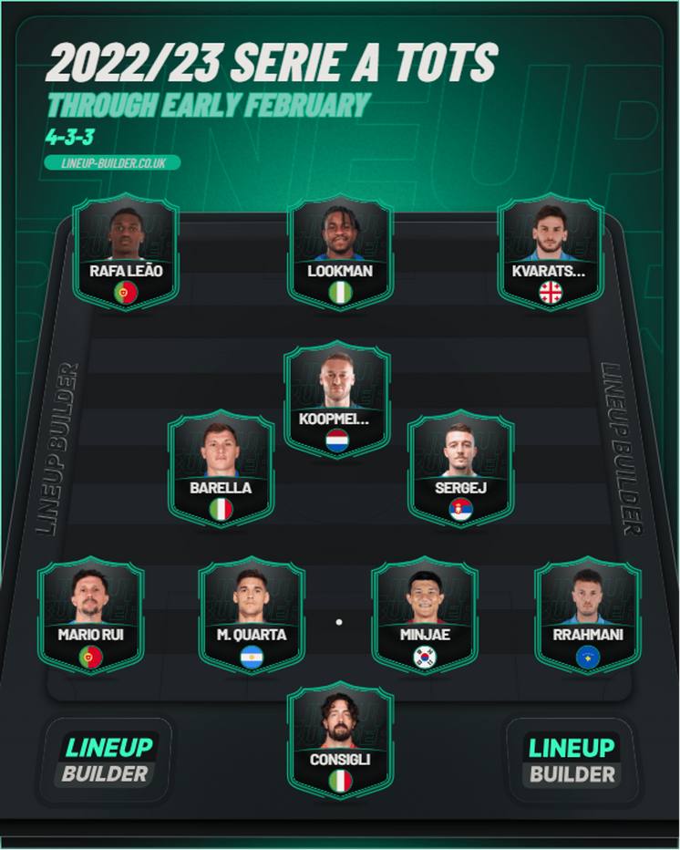
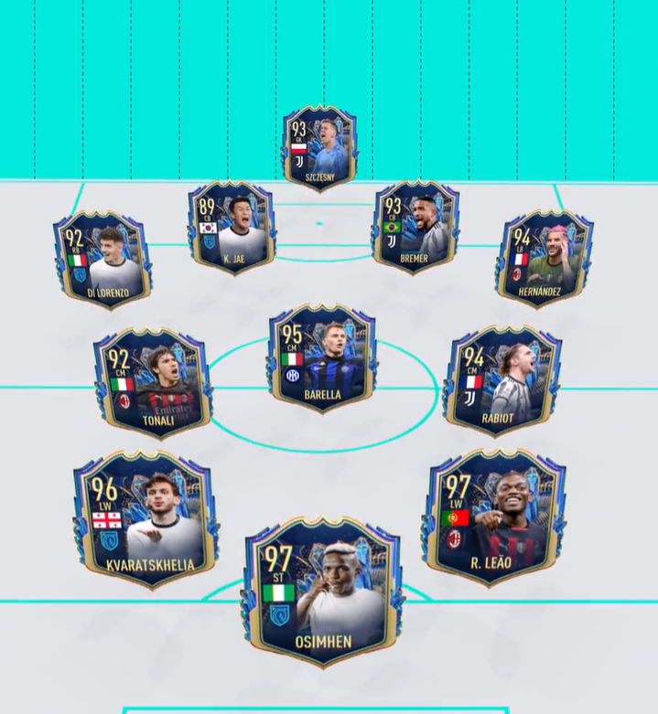
Serie A (Italy)
Calculated TOTS
Official TOTS

Slide 22
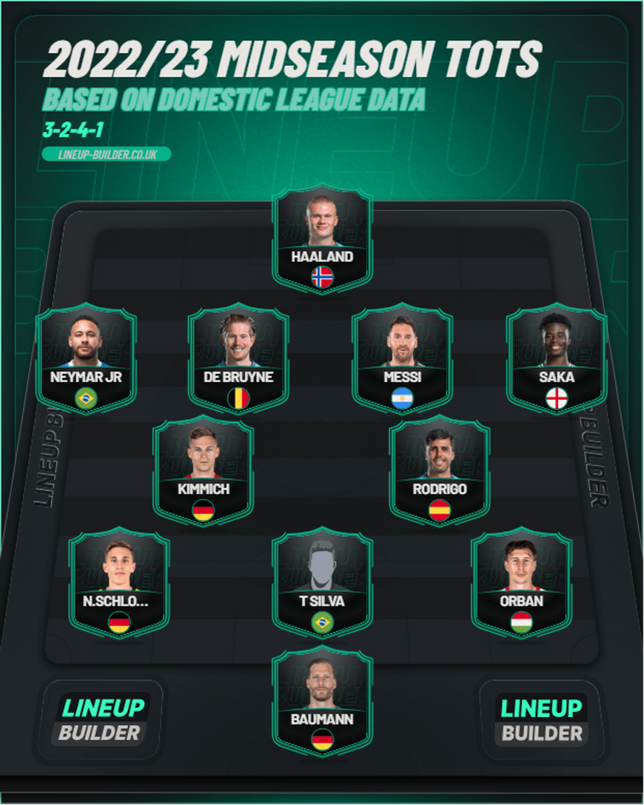
Overall Team Of The Season
Highest Rated Forward: Lionel Messi (305)
Highest Rated Midfielder: Kevin De Bruyne (421)
Highest Rated Defender: Willi Orban (181)
Highest Rated Goalkeeper: Oliver Baumann (105)

Slide 23
Major Drawbacks
Limited Player Positions
Very Little Goalkeeping or Defending Data
Only 60% of the Season Covered
League Standings aren’t involved

Slide 24
Conclusion

Slide 25
Questions?

